Slide 1
Lions International British Isles

Slide 2
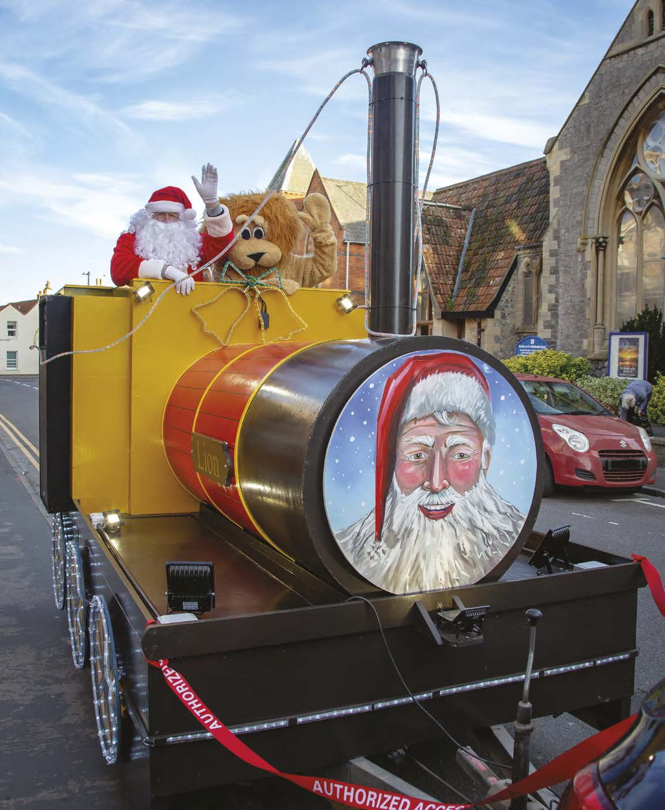
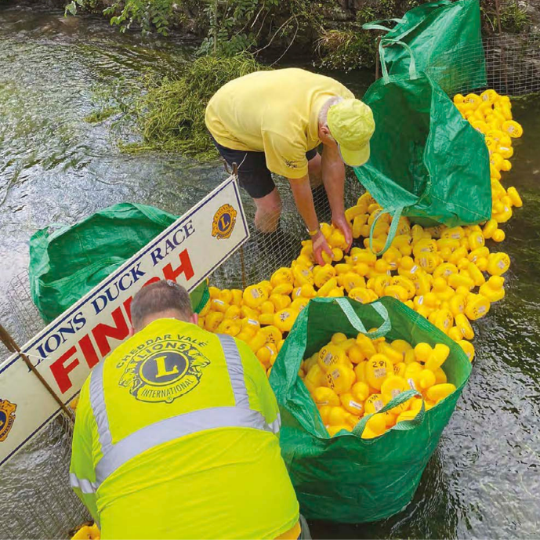
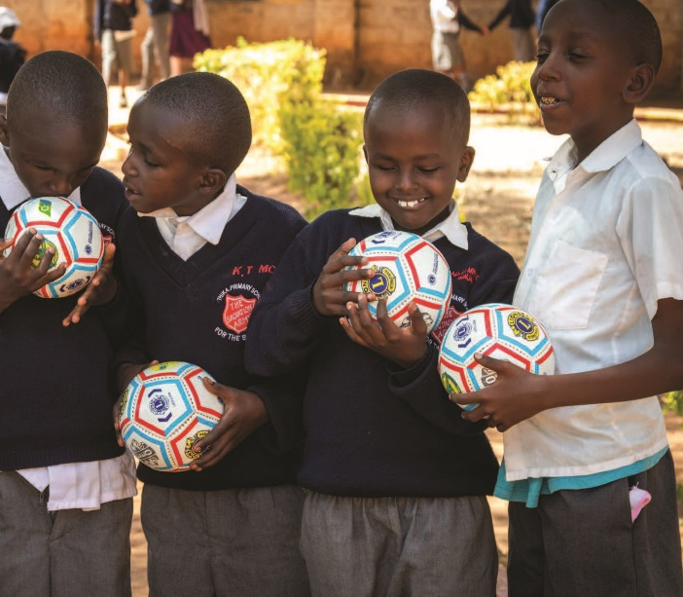
aa
Lions motto
We Serve
Lions are ordinary people who achieve extraordinary things by helping others and supporting good causes.
1.4 million Lions serve local communities in 200+ countries and geographic areas worldwide.
2

Slide 3
aa
Lions global causes
Together we tackle five causes, locally and globally.
DIABETES
We help to prevent diabetes and improve the quality of life of people living with a diagnosis.
ENVIRONMENT
We help to protect and restore our environment sustainably and improve community well being.
HUNGER
We help to address hunger and improve the availability of nutritious food.
VISION
We help to reduce avoidable blindness and improve the lives of those affected by visual impairments.
CHILDHOOD CANCER
We help to address causes of cancer and improve the future of young patients and their families.
3

Slide 4
Our Club
[name of Lions Club]

Slide 5
aa
Our club within our community
We serve the local community of
[name geographic area]
[Explain how your club supports the local community - listing activities, events, projects and partnerships.]
5

Slide 6
aa
Our club within our community
We serve the local community of
[name geographic area]
[Continue here if more than one slide is required.]
6

Slide 7
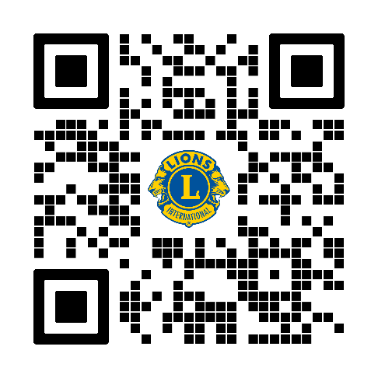
aa
Next steps
Get involved with [Name of Lions club]
Join us. Volunteer to support a range of
projects, community activities and good
causes.
Step forward. Help Lions create remarkable
and memorable events, raise funds and
have fun.
Contact details [add in here]
7

Slide 8
Thank you for listening
Produced by the Lions Marketing & PR Team

